Slide 1

Management Information Systems: Managing the Digital Firm
Sixteenth Edition
Chapter 9
Achieving Operational Excellence and Customer Intimacy: Enterprise Applications
Copyright © 2020, 2018, 2016 Pearson Education, Inc. All Rights Reserved
Notes:
If this PowerPoint presentation contains mathematical equations, you may need to check that your computer has the following installed:
1) MathType Plugin
2) Math Player (free versions available)
3) NVDA Reader (free versions available)

Slide 2
Learning Objectives
9.1 How do enterprise systems help businesses achieve operational excellence?
9.2 How do supply chain management systems coordinate planning, production, and logistics with suppliers?
9.3 How do customer relationship management systems help firms achieve customer intimacy?
9.4 What are the challenges that enterprise applications pose, and how are enterprise applications taking advantage of new technologies?
9.5 How will M I S help my career?
Notes:
This chapter looks at enterprise systems, which collect and integrate data from many different departments and systems throughout the business. Ask students to review what operational excellence is. What is customer intimacy and why does this help the business? Have they ever heard of “supply chains” before?

Slide 3
Video Cases
Case 1: Life Time Fitness Gets in Shape with Salesforce C R M
Instructional Video: G S M S Protects Patients by Serializing Every Bottle of Drugs

Slide 4
Avon Beautifies Its Supply Chain (1 of 2)
Problem
Volatile demand
Global operations
Complex supply chain
Manual processes
Solutions
Revise supply chain processes
Deploy J D A Manufacturing
Intelligent Fulfillment

Slide 5
Avon Beautifies Its Supply Chain (2 of 2)
Avon uses J D A’s Manufacturing and Intelligent Fulfillment system to gain control over its supply chain and inventory, and estimate future needs to integrate business processes and decision making
Demonstrates why companies need enterprise applications
Illustrates the ability of E R P systems to dramatically improve operational effectiveness and decision making on a global scale

Slide 6
Enterprise Systems
Enterprise resource planning (E R P) systems
Suite of integrated software modules and a common central database
Collects data from many divisions of firm for use in nearly all of firm’s internal business activities
Information entered in one process is immediately available for other processes
Notes:
This slide describes the main purpose of enterprise systems. Ask students for examples of why it might be valuable to have information from one process instantly available to another process.
The text cites the example of Alcoa, which implemented enterprise software to eliminate redundant processes and systems, reduce requisition-pay-to-cycle time, reduce 20 percent of worldwide costs. This illustrates the tremendous value that an effective implementation of enterprise software can have.

Slide 7
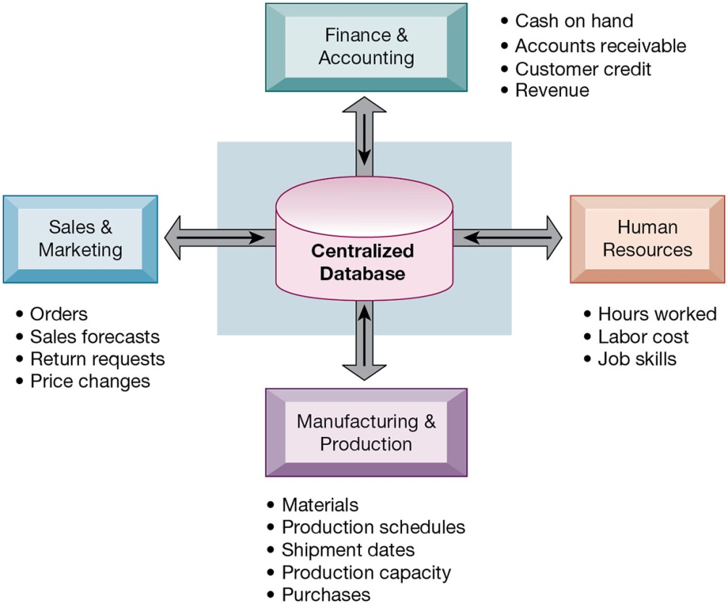
Figure 9.1 How Enterprise Systems Work
Notes:
Figure 9.1, Page 342.
Enterprise systems feature a set of integrated software modules and a central database by which business processes and functional areas throughout the enterprise can share data.
This graphic illustrates the function of enterprise software to integrate and share data between the different business functions. One of the key ideas of enterprise solutions is that there’s “one company, one database” and not a collection of disconnected databases.
Full description: A diagram depicts the working of enterprise systems. The diagram shows the centralized database connected to various components as follows. Finance and Accounting, includes Cash on hand, Accounts receivable, Customer credit, and Revenue. Human Resources, includes Hours worked, Labor cost, and Job skills. Manufacturing and Production, includes Materials, Production schedules, Shipment dates, Production capacity, and Purchases. Sales and Marketing, includes Orders, Sales forecasts, Return requests, and Price changes.

Slide 8
Enterprise Software
Built around thousands of predefined business processes that reflect best practices
Finance and accounting
Human resources
Manufacturing and production
Sales and marketing
To implement, firms:
Select functions of system they wish to use
Map business processes to software processes
Use software’s configuration tables for customizing
Notes:
This slide describes the functions in an enterprise software package and how it would be implemented by a firm. Ask students why it is typically best to perform only minimal changes to enterprise software, and instead, change the way the firm works in order to conform to the software’s business processes.

Slide 9
Business Value of Enterprise Systems
Increase operational efficiency
Provide firm-wide information to support decision making
Enable rapid responses to customer requests for information or products
Include analytical tools to evaluate overall organizational performance and improve decision-making
Notes:
This slide discusses the business values of enterprise systems. What does it mean for the firm that enterprise systems enforce the use of common standardized definitions and formats for data by the entire organization?

Slide 10
The Supply Chain
Network of organizations and processes for:
Procuring materials
Transforming materials into products
Distributing the products
Upstream supply chain
Downstream supply chain
Internal supply chain
Notes:
This slide introduces the concept of the supply chain. Supply chain management software is a type of enterprise software for managing complicated supply chains that may include thousands of suppliers.
The text gives the example of Nike’s sneakers’ supply chain. What types of firms are in the upstream supply chain? In the downstream supply chain?

Slide 11
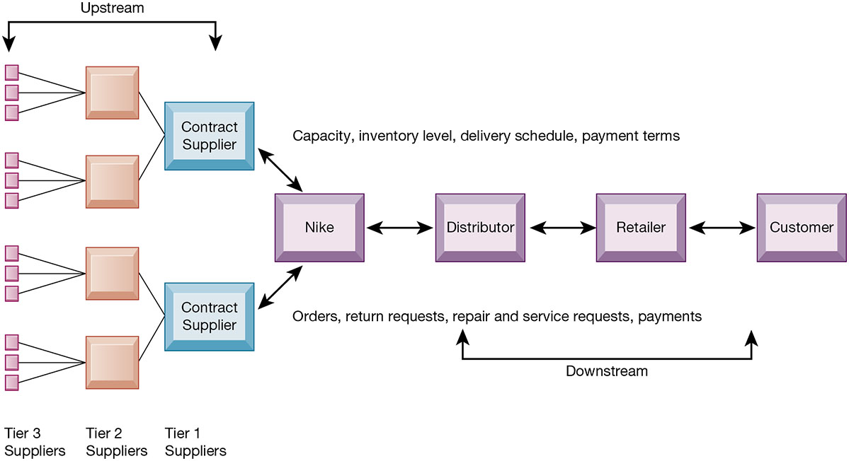
Figure 9.2 Nike’s Supply Chain
Notes:
Figure 9.2, Page 347.
This figure illustrates the major entities in Nike’s supply chain and the flow of information upstream and downstream to coordinate the activities involved in buying, making, and moving a product. Shown here is a simplified supply chain, with the upstream portion focusing only on the suppliers for sneakers and sneaker soles.
This graphic illustrates the major entities in Nike’s supply chain. Ask students what the difference is between tier 1, 2, and 3 suppliers.
Full description: A diagram shows Nike’s supply chain. The diagram shows Nike in the middle with the upstream flow as Tier 1, Tier 2, and Tier 3 suppliers. The downstream flow in sequence shows distributor, retailer, and customer. The activities shown are capacity, inventory level, delivery schedule, payment terms, orders, return requests, repair and service requests, and payments.

Slide 12
Supply Chain Management
Inefficiencies cut into a company’s operating costs
Can waste up to 25 percent of operating expenses
Just-in-time strategy
Components arrive as they are needed
Finished goods shipped after leaving assembly line
Safety stock: buffer for lack of flexibility in supply chain
Bullwhip effect
Information about product demand gets distorted as it passes from one entity to next across supply chain
Notes:
This slide discusses the effects of timely and untimely information on a supply chain. Ask students what causes inefficiencies in a supply chain (parts shortages, underutilized plant capacity, excessive finished goods inventory, high transportation costs). These are caused by untimely information. Perfect information can result in a just-in-time strategy.
Because of uncertainties, manufacturers keep a safety stock. Why is this an inefficient result? Another effect of uncertainties is the bullwhip effect.

Slide 13
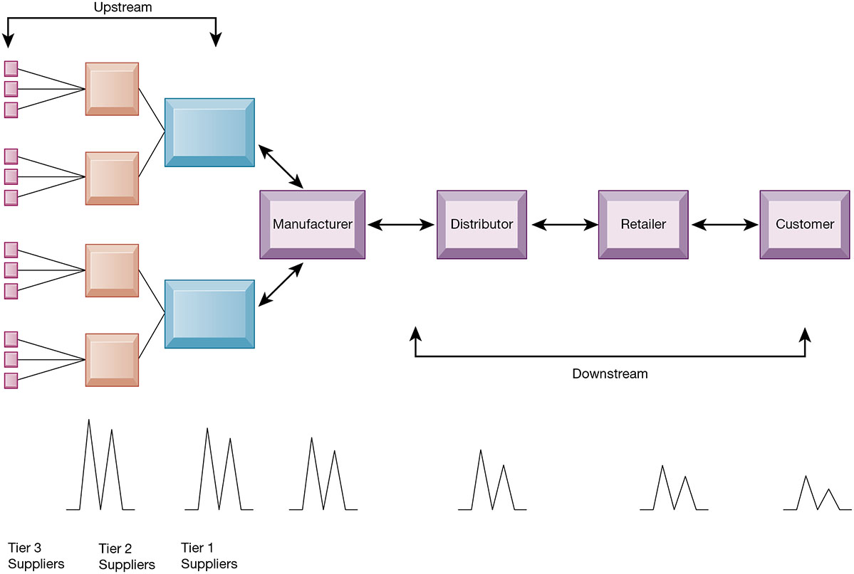
Figure 9.3 The Bullwhip Effect
Notes:
Figure 9.3, Page 349.
Inaccurate information can cause minor fluctuations in demand for a product to be amplified as one moves further back in the supply chain. Minor fluctuations in retail sales for a product can create excess inventory for distributors, manufacturers, and suppliers.
This graphic illustrates how a slight rise in demand by customers for an item will cause successive participants to slightly overstock related inventory “just in case.” These changes are amplified as one moves back further in the system.
Full description: A diagram shows the effect of inaccurate information at various levels of Nike’s supply chain. The diagram shows Nike in the middle with the upstream flow as suppliers on the left and the downstream flow in sequence to the right as distributor, retailer, and customer. The effect is shown by an M-shaped pattern, which decreases in size from left to right.

Slide 14
Supply Chain Management Software
Supply chain planning systems
Model existing supply chain
Enable demand planning
Optimize sourcing, manufacturing plans
Establish inventory levels
Identify transportation modes
Supply chain execution systems
Manage flow of products through distribution centers and warehouses
Notes:
This slide discusses the two main types of supply chain management systems. Ask students to explain and describe the concept of “demand planning.” It determines how much product a business needs to make to satisfy customer demand.

Slide 15
Global Supply Chains and the Internet
Global supply chain issues
Greater geographical distances, time differences
Participants from different countries
Different performance standards
Different legal requirements
Internet helps manage global complexities
Warehouse management
Transportation management
Logistics
Outsourcing
Notes:
This slide discusses the additional complexities experienced by global supply chains. Today’s apparel industry relies heavily on outsourcing to contract manufacturers in China and other low-wage countries. Apparel companies use the web extensively to manage their global supply chain and production issues.

Slide 16
Demand-Driven Supply Chains: From Push to Pull Manufacturing and Efficient Customer Response
Push-based model (build-to-stock)
Earlier S C M systems
Schedules based on best guesses of demand
Pull-based model (demand-driven)
Web-based
Customer orders trigger events in supply chain
Internet enables move from sequential supply chains to concurrent supply chains
Complex networks of suppliers can adjust immediately
Notes:
This slide discusses the fact that SCM systems facilitate efficient customer response, allowing the workings of the business to be driven more by customer demand, moving from push-based, sequential models to pull-based, concurrent models of production. Ask students for examples from the text of the pull-based model (Walmart, Dell).

Slide 17
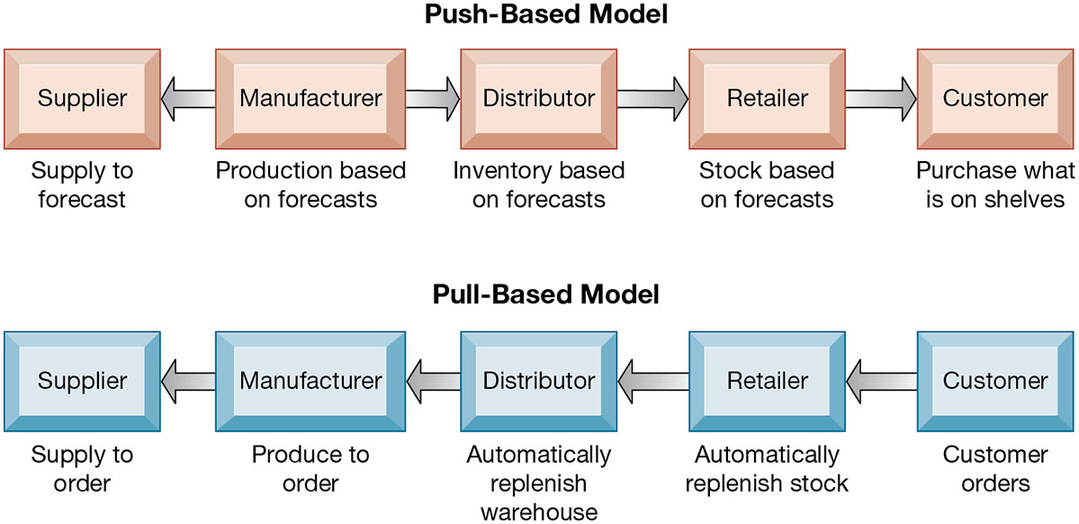
Figure 9.4 Push- Versus Pull-Based Supply Chain Models
Notes:
Figure 9.4, Page 351.
The difference between push- and pull-based models is summarized by the slogan “Make what we sell, not sell what we make.”
This graphic illustrates the difference between the earlier, push-based model of supply chains to the pull-based model. Ask students if there are some industries uniquely suited to the pull-based model. How about automobiles, appliances, and consumer durables? What are the drawbacks of a pull-based model?
Full description: A diagram compares the push- and pull-based models. The push-based model shows supplier left of the manufacturer with a left arrow between them and an arrow between the other components right of the manufacturer as follows. The Supplier, Supply to forecast. The Manufacturer, Production based on forecast. The Distributor, Inventory based on forecast. The Retailer, Stock based on forecast. The Customer, Purchase what is on shelves. The pull-based model shows a left arrow between all of the components in sequence from left to right as follows. The Supplier, Supply to order. The Manufacturer, Produce to order. The distributor, Automatically replenish warehouse. The Retailer, Automatically replenish stock. The Customer, Customer orders.

Slide 18
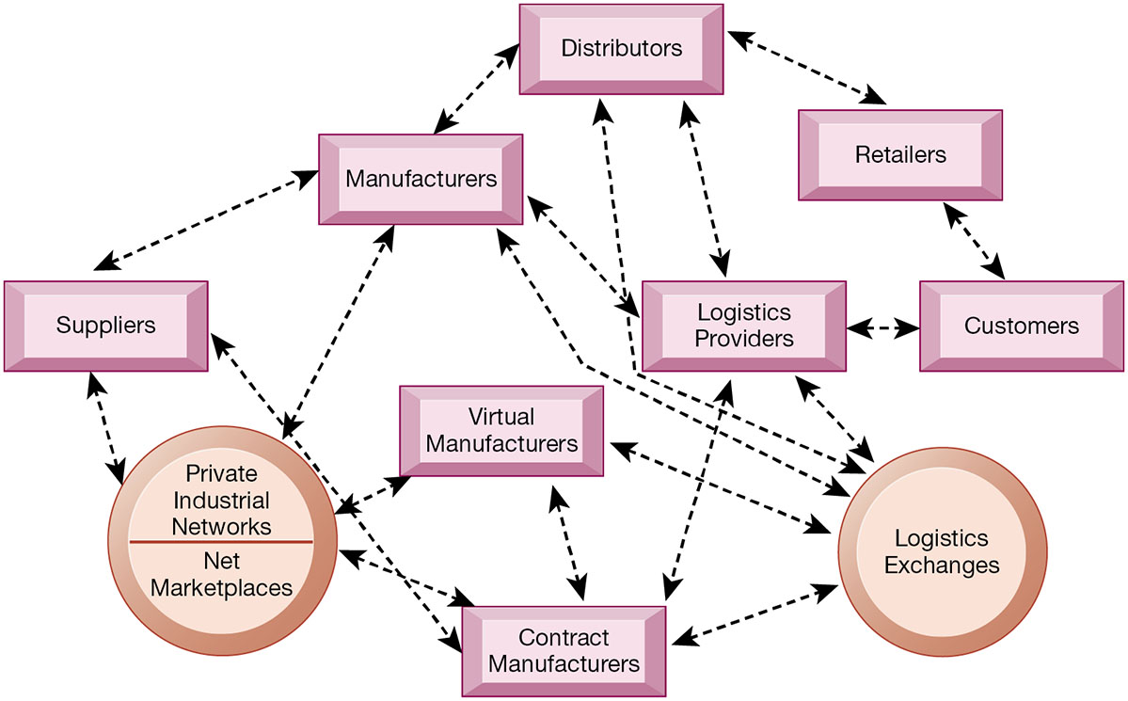
Figure 9.5 The Emerging Internet-Driven Supply Chain
Notes:
Figure 9.5, Page 352.
The emerging Internet-driven supply chain operates like a digital logistics nervous system. It provides multidirectional communication among firms, networks of firms, and e-marketplaces so that entire networks of supply chain partners can immediately adjust inventories, orders, and capacities.
This graphic illustrates the multidirectional communications within a future supply chain driven by the Internet. Private industrial networks and net marketplaces are discussed in Chapter 10. Private industrial networks are typically a large firm using an extranet to link to its suppliers and other key business partners. Net marketplaces are digital marketplaces based on Internet technology for many different buyers and sellers.
Full description: A diagram depicts the structure of an internet-driven supply chain. The diagram shows Private Industrial Networks and Net Marketplaces connected to Logistics Exchanges through a web-like structure with components in between as follows. Suppliers, Manufacturers, Virtual Manufacturers, Contract Manufacturers, Distributors, Logistic Providers, Retailers, and Customers.

Slide 19
Business Value of Supply Chain Management Systems
Match supply to demand
Reduce inventory levels
Improve delivery service
Speed product time to market
Use assets more effectively
Total supply chain costs can be 75 percent of operating budget
Increase sales
Notes:
This slide examines the value of using SCM systems to businesses. Ask students how increased sales can result from a more efficient supply chain.

Slide 20
Interactive Session: Management: Soma Bay Prospers with E R P in the Cloud
Class discussion
Identify and describe the problem discussed in this case. What management, organization, and technology factors contributed to the problem?
Why was an E R P system required for a solution? How did having a cloud-based E R P system contribute to the solution?
What were the business benefits of Soma Bay’s new enterprise system? How did it change decision making and the way the company operated?

Slide 21
Customer Relationship Management
Knowing the customer
In large businesses, too many customers and too many ways customers interact with firm
C R M systems
Capture and integrate customer data from all over the organization
Consolidate and analyze customer data
Distribute customer information to various systems and customer touch points across enterprise
Provide single enterprise view of customers
Notes:
This slide introduces the concept of customer relationship management as a key function of the business and the use of CRM systems to provide a single place to consolidate and analyze data about the customer. Ask students to provide examples of the different types of customer data that would be captured by a firm. What types of valuable information does the firm need to know about its customers (most profitable, loyal customers). Have students directly interacted with a CRM? They probably do not know it, but anytime they call into a call center for help they are dealing with some kind of CRM that tracks some or all of their interactions with a firm.

Slide 22
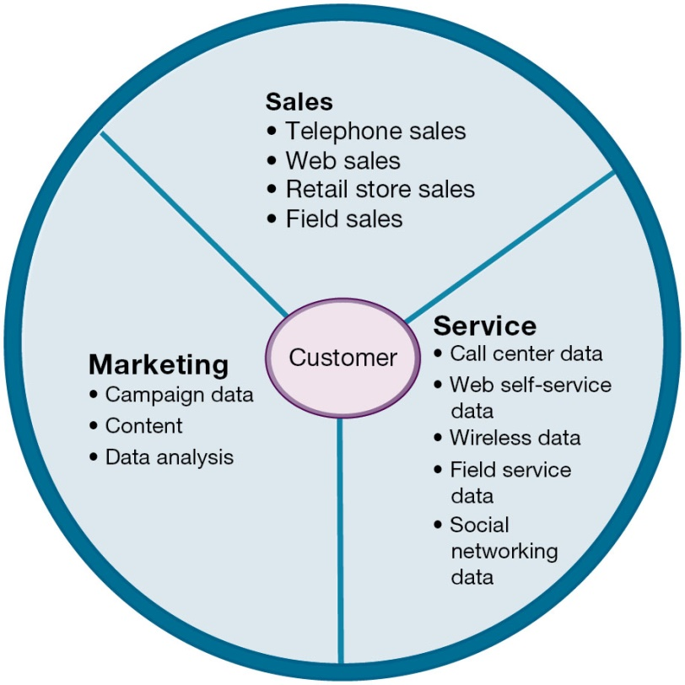
Figure 9.6 Customer Relationship Management (C R M)
Notes:
Figure 9.6, Page 354.
CRM systems examine customers from a multifaceted perspective. These systems use a set of integrated applications to address all aspects of the customer relationship, including customer service, sales, and marketing.
This graphic illustrates the functions found in the integrated applications of a CRM system.
Full description: A diagram shows the components of the Customer Relationship Management, or C R M. The diagram shows the Customer in the middle with associated components shown as follows. Sales, includes Telephone sales, Web sales, Retail store sales, and Field sales. Service, includes Call center data, Web self-service data, Wireless data, Field service data, and Social networking data. Marketing, includes campaign data, Content, and Data analysis.

Slide 23
Customer Relationship Management Software (1 of 2)
Packages range from niche tools to large-scale enterprise applications
More comprehensive packages have modules for:
Partner relationship management (P R M)
Integrating lead generation, pricing, promotions, order configurations, and availability
Tools to assess partners’ performances
Employee relationship management (E R M)
Setting objectives, employee performance management, performance-based compensation, employee training
Notes:
This slide discusses the types of CRM software available, which range from niche tools to full-scale enterprise-wide applications. Ask students for examples of PRM functions (integrating lead generation, pricing, promotions, order configurations, and availability, tools to assess partners’ performances) and ERM functions (setting objectives, employee performance management, performance-based compensation, employee training).

Slide 24
Customer Relationship Management Software (2 of 2)
C R M packages typically include tools for:
Sales force automation (S F A)
Sales prospect and contact information
Sales quote generation capabilities
Customer service
Assigning and managing customer service requests
Web-based self-service capabilities
Marketing
Capturing prospect and customer data, scheduling and tracking direct-marketing mailings or e-mail
Cross-selling

Slide 25
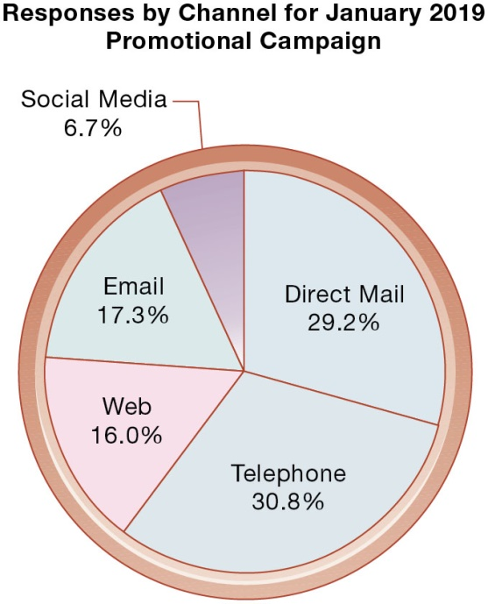
Figure 9.7 How C R M Systems Support Marketing
Responses by Channel for January 2019 Promotional Campaign
Notes:
Figure 9.7, Page 355.
Customer relationship management software provides a single point for users to manage and evaluate marketing campaigns across multiple channels, including e-mail, direct mail, telephone, the Web, and social media.
This graphic gives an example of how CRM systems can support marketing by analyzing and evaluating marketing campaigns.

Slide 26
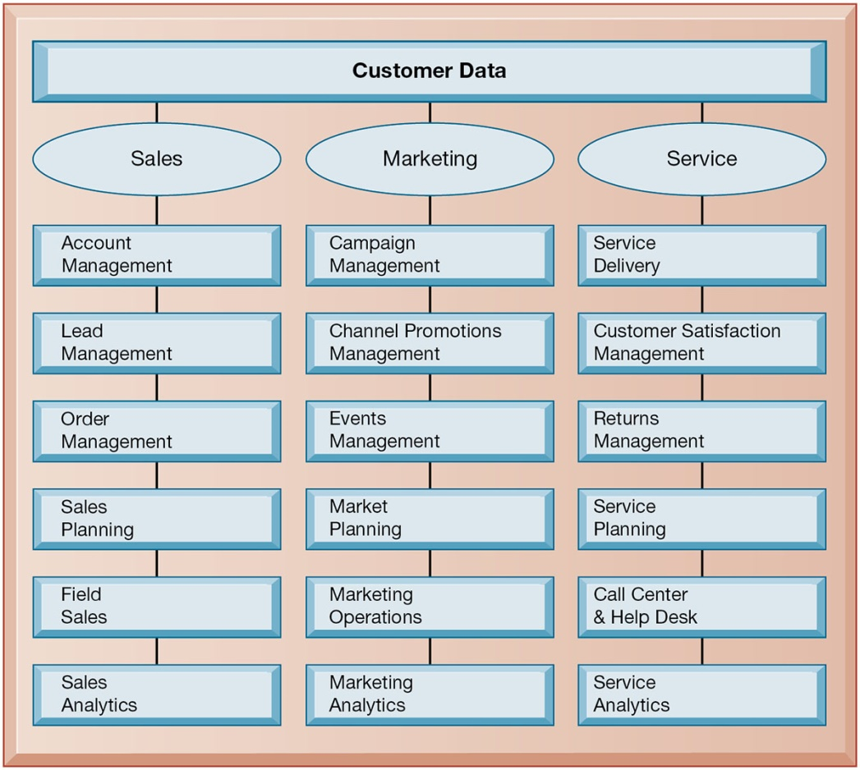
Figure 9.8 C R M Software Capabilities
Notes:
Figure 9.8, Page 356.
The major CRM software products support business processes in sales, service, and marketing, integrating customer information from many sources. Included is support for both the operational and analytical aspects of CRM.
This graphic illustrates the range of functions included in the sales, marketing, and service modules in a CRM package. As noted in the text, CRM software is business-process driven, incorporating hundreds of business processes thought to represent best practices in each of these areas. To achieve maximum benefit, companies need to revise and model their business processes to conform to the best-practice business processes in the CRM software.
Full description: A chart shows the most important capabilities for sales, service, and marketing processes found in major C R M software products. The capabilities shown are as follows. Under Sales is Account Management, Lead Management, Order Management, Sales Planning, Field Sales, and Sales Analytics. Under Marketing is Campaign Management, Channel Promotions Management, Events Management, Market Planning, Marketing Operations, and Marketing Analytics. Under Service is Service Delivery, Customer Satisfaction Management, Returns Management, Service Planning, Call Center and Help Desk, and Service Analytics.

Slide 27
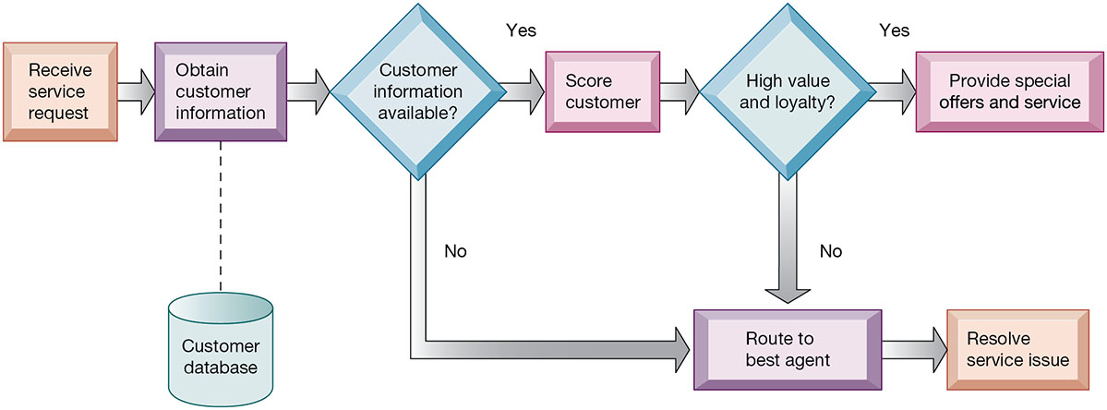
Figure 9.9 Customer Loyalty Management Process Map
Notes:
Figure 9.9, Page 357.
This process map shows how a best practice for promoting customer loyalty through customer service would be modeled by customer relationship management software. The CRM software helps firms identify high-value customers for preferential treatment.
This graphic illustrates how a best practice for increasing customer loyalty through customer service might be modeled by CRM software. What kinds of information might indicate that a customer is loyal or high value?
Full description: A flow diagram depicts the customer loyalty management process map. The diagram shown is as follows. Receive service request, Obtain customer information from customer database, if Customer information is not available, then Route to best agent, and Resolve service issue. If Customer information is available, then Score the customer. If the answer is no for High value and loyalty, then Route to best agent, and Resolve service issue. If the answer is Yes, then Provide special offers and service.

Slide 28
Operational and Analytical C R M
Operational C R M
Customer-facing applications
Sales force automation call center and customer service support
Marketing automation
Analytical C R M
Based on data warehouses populated by operational C R M systems and customer touch points
Analyzes customer data (O L A P, data mining, etc.)
Customer lifetime value (C L T V)
Notes:
This slide discusses the two main types of CRM software—operational and analytical. Ask students how the CLTV is calculated (it is based on the relationship between the revenue produced by a specific customer, the expenses incurred in acquiring and servicing that customer, and the expected life of the relationship between the customer and the company.)

Slide 29
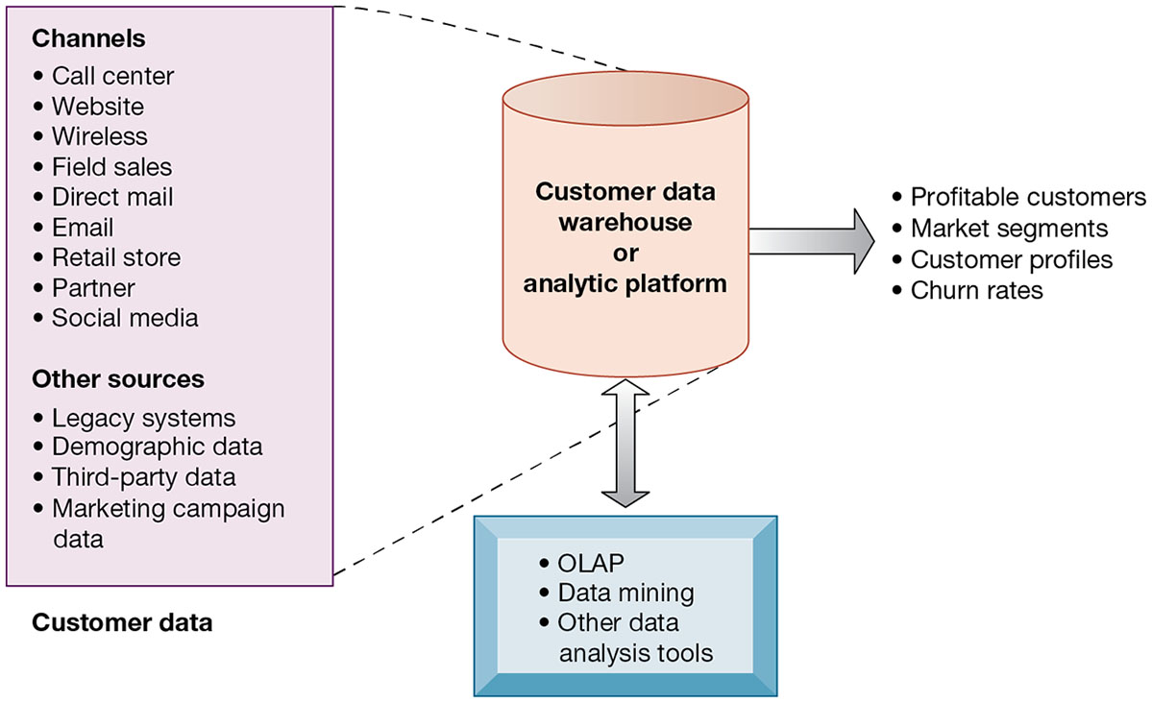
Figure 9.10 Analytical C R M Data Warehouse
Notes:
Figure 9.10, Page 358.
Analytical CRM uses a customer data warehouse or analytic platform and tools to analyze customer data collected from the firm’s customer touch points and from other sources.
This graphic illustrates the main components of analytical CRM. Data is captured from various channels and fed into a customer data warehouse, where OLAP, data mining, and other analysis tools help identify profitable customers, churn rates, and so on.
Full description: A diagram shows the elements of an analytical C R M Data warehouse. The diagram shows various channels and sources to collect customer data as follows. The Channels are Call center, Website, Wireless, Field sales, Direct mail, E-mail, Retail store, Partner, and Social media. The Other sources are Legacy systems, Demographic data, Third-party data, and Marketing campaign data. The examples of customer data warehouse or analytic platform shown are as follows. Profitable customers, Market segments, Customer profiles, and Churn rates. The tools shown are O L A P, Data mining, and Other data analysis tools.

Slide 30
Interactive Session – Organizations: Kenya Airways Flies High with Customer Relationship Management
Class discussion
What was the problem at Kenya Airways described in this case? What people, organization, and technology factors contributed to this problem?
What was the relationship of customer relationship management to Kenya Airway’s business performance and business strategy?
Describe Kenya Airway’s solution to its problem. What people, organization, and technology issues had to be addressed by the solution?
How effective was this solution? How did it affect the way Kenya Airways ran its business and its business performance?

Slide 31
Business Value of Customer Relationship Management Systems
Business value of C R M systems
Increased customer satisfaction
Reduced direct-marketing costs
More effective marketing
Lower costs for customer acquisition/retention
Increased sales revenue
Churn rate
Number of customers who stop using or purchasing products or services from a company
Indicator of growth or decline of firm’s customer base
Notes:
This slide discusses the value to businesses of implementing a CRM system. How would marketing be made more effective by using a CRM system?

Slide 32
Enterprise Application Challenges
Expensive to purchase and implement enterprise applications
Multi-million dollar projects in 2018
Long development times
Technology changes
Business process changes
Organizational learning, changes
Switching costs, dependence on software vendors
Data standardization, management, cleansing
Notes:
This slide looks at the challenges firms face when they implement enterprise applications. Ask students to explain and apply with examples the concept of “switching costs.” What problems could result from being dependent on a single software vendor?

Slide 33
Next-Generation Enterprise Applications (1 of 2)
Enterprise solutions/suites
Make applications more flexible, web-enabled, integrated with other systems
S O A standards
Open-source applications
On-demand solutions
Cloud-based versions
Functionality for mobile platform
Notes:
This slide looks at the trends in enterprise software. The text cites the example of enterprise solutions from SAP, which combines key applications in finance, logistics, and procurement, and human resources administration into a core ERP component. Businesses then extend these applications by linking to function-specific web services such as employee recruiting or collections management provided by SAP and other vendors. SAP provides more than 500 web services through its website. Ask students to define open-source and on-demand. What are the benefits of service platforms?

Slide 34
Next-Generation Enterprise Applications (2 of 2)
Social C R M
Incorporating social networking technologies
Company social networks
Monitor social media activity; social media analytics
Manage social and web-based campaigns
Business intelligence
Inclusion of B I with enterprise applications
Flexible reporting, ad hoc analysis, “what-if” scenarios, digital dashboards, data visualization
Notes:
This slide looks at the trends in enterprise software. The text cites the example of enterprise solutions from SAP, which combines key applications in finance, logistics, procurement, and human resources administration into a core ERP component. Businesses then extend these applications by linking to function-specific web services such as employee recruiting or collections management provided by SAP and other vendors. SAP provides more than 500 web services through its website.
Ask students to define open-source and on-demand. What are the benefits of service platforms?

Slide 35
How Will M I S Help My Career?
The Company: X Y Z Global Industrial Components
Position Description: Manufacturing management trainee
Job Requirements
Interview Questions
Author Tips
Notes:
A good opportunity for a class discussion of the new Section on careers. Would any in the class be interested in a job like this? What do they think are the most important skills the employer is looking for? How would they answer the interviewer questions?

Slide 36

Copyright
This work is protected by United States copyright laws and is provided solely for the use of instructors in teaching their courses and assessing student learning. Dissemination or sale of any part of this work (including on the World Wide Web) will destroy the integrity of the work and is not permitted. The work and materials from it should never be made available to students except by instructors using the accompanying text in their classes. All recipients of this work are expected to abide by these restrictions and to honor the intended pedagogical purposes and the needs of other instructors who rely on these materials.

